Slide 1
OECD INDR Workshop 7 June 2022
Presentation slides from Martha Baxter, OECD, Sarah Smith, BEIS and Frank Denton, RPRA

Slide 2
Institutional arrangements, capture and accountability
Lessons from the Network of Economic Regulators (NER)
Martha Baxter, Acting Senior Policy Analyst
INDR/OECD Practitioner Workshop: Institutional Arrangements, Capture and Accountability
7 June 2022

Slide 3
Regulatory integrity as the antidote to regulatory capture
A high degree of regulatory integrity helps achieve decision making which is objective, impartial, consistent, and avoids the risks of conflict, bias or improper influence.
Source: OECD (2014), Best Practice Principles on the Governance of Regulators

Slide 4
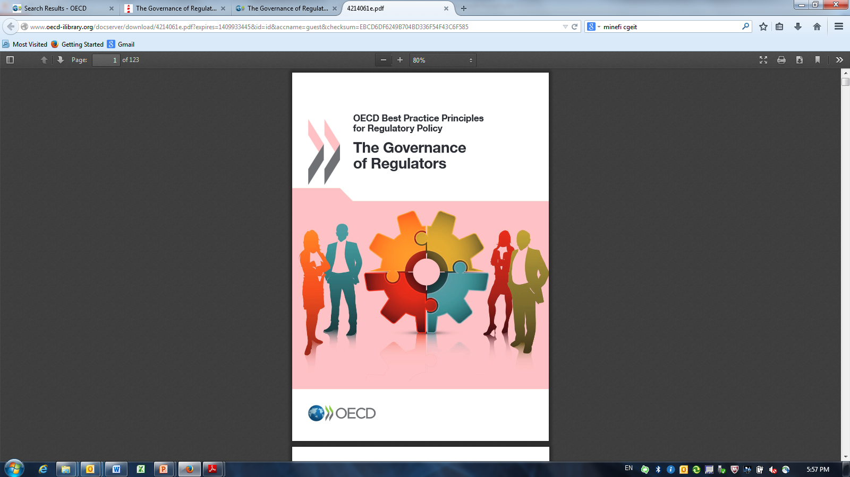
To avoid capture and support accountability, governance matters
1. Role clarity
7. Performance assessment
2.Preventing undue influence
6. Funding
3. Decision making and board structure
5. Stakeholder enagegement
4. Transparency and accountability
Source(s): OECD (2014), Best Practice Principles on the Governance of Regulators

Slide 5
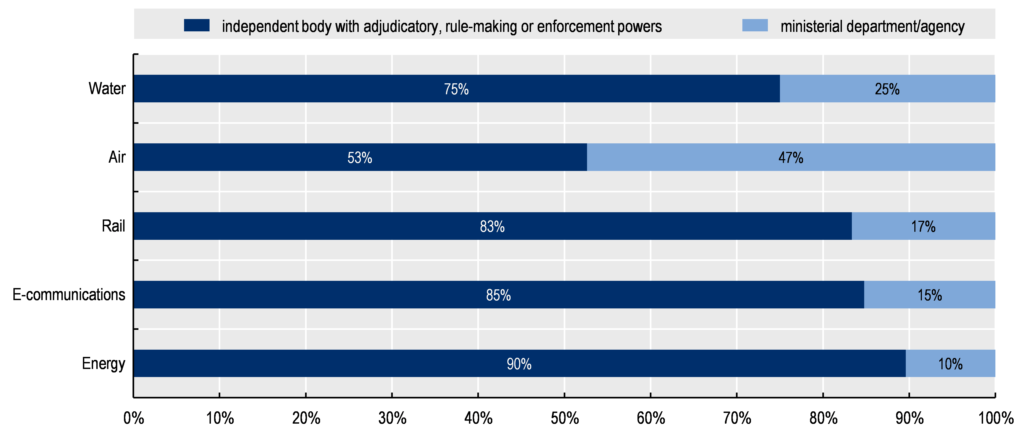
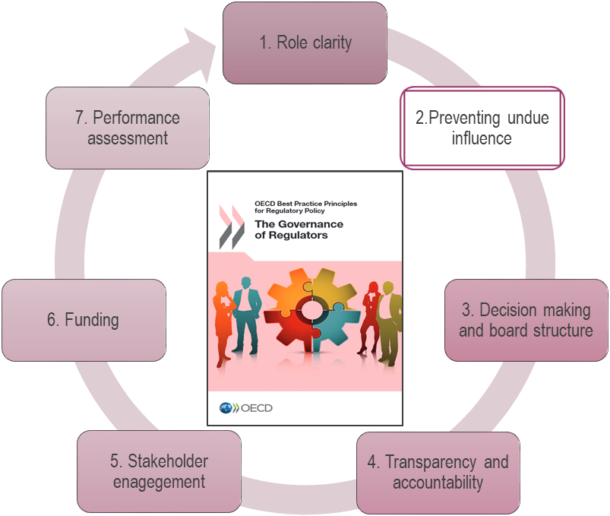
Regulators are often independent bodies
Legal status of regulators, by sector
Source(s): OECD (2021), Regulatory Policy Outlook 2021

Slide 6
Preventing undue influence
Establishment of independent regulator?
Empirical, analytical basis for major decisions
Stakeholder consultation
Recusal clause for all staff and board members

Slide 7


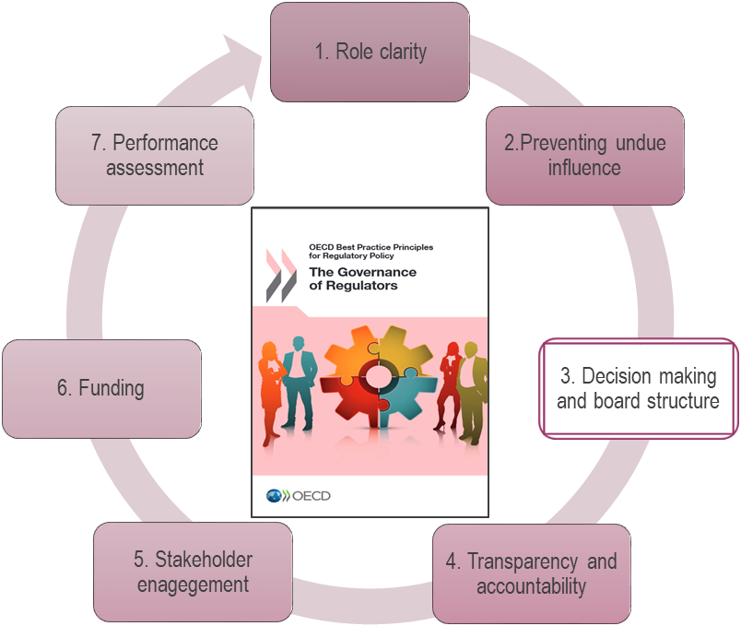
Decision-making and Board structure
Decision-making model: multi-member vs single
Board Membership
A group of decision makers is less likely to be “captured” than an individual
Policies, procedures and criteria for selection and terms of appointment of the governing body members should be in line with guidelines for public entity board appointments and documented and readily available to all affected parties

Slide 8
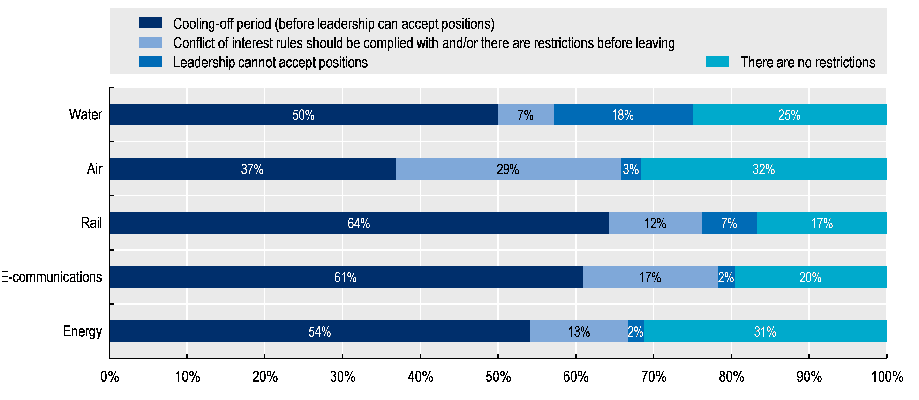
There are usually restrictions for the regulator’s leadership to prevent a conflict of interest
Restrictions on regulator’s leadership after their term to accept government and/or sector positions related to the regulated sector, by sector
Source(s): OECD (2021), Regulatory Policy Outlook 2021

Slide 9
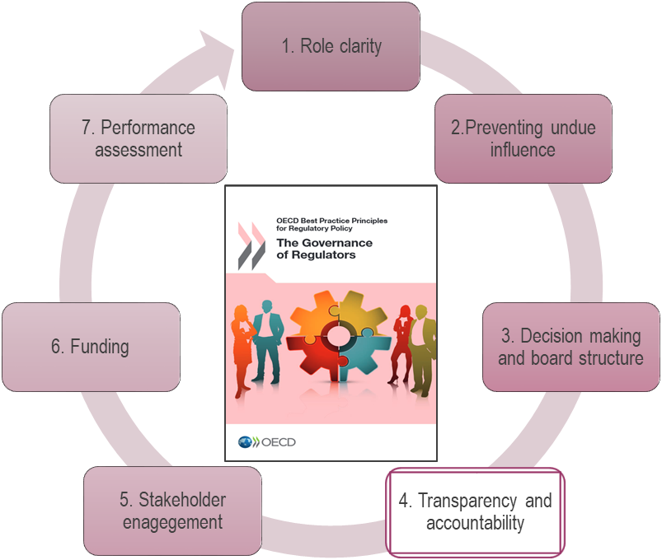
Accountability and transparency
To ministers or legislature
Statement of expectations
Annual reporting on performance
To regulated entities
Transparency of operational policies covering compliance as well as enforcement and decision reviews
Avenues for complaint and redress, e.g. internal review of delegated decisions (e.g. of inspectors); right of appeal through judicial process
To the public
All major decisions made publicly available, complete with justification
Independent reviews of significant regulatory decisions as a matter of course

Slide 10
Regulators can support accountability through transparency initiatives
  Australia’s multi-sector regulator ACCC posts on its website its compliance and enforcement policy and priorities, which includes priorities for the calendar year as well as enduring priorities
  Brazil’s electricity regulator ANEEL improves transparency on board decision making through the live-streaming of board meetings on the regulator’s website and YouTube
Source(s): OECD (2021), Driving Performance at Brazil’s Electricity Regulatory Agency
Notes:
ANEEL
ANEEL’s decision-making processes show a strong emphasis on transparency. ANEEL makes its decision-making processes accessible to a broader public using several strategies. Before, during and after board meetings, ANEEL provides access to consumers to encourage transparency. At least five days before a board meeting, ANEEL releases the board meeting agenda to the public. The meetings themselves are open to the public and live-streamed online. After the meeting, ANEEL publishes a summary record of the board’s actions. ANEEL publishes decisions and supporting documents in the Official Gazette and ANEEL’s website.
ACCC
Example of transparent regulatory planning with the Australian Competition and Consumer Commission (ACCC)
The ACCC post on its website its compliance and enforcement policy and priorities, which includes priorities for the calendar year as well as enduring priorities for forms of conduct considered so detrimental to consumer welfare and competitive processes that the ACCC will always regard them as a priority. The policy statement includes details about the principles and approaches underlying the policy, the compliance and enforcement strategy, priority factors, compliance activities, enforcement actions, and market studies. A section is also included for co-ordination with other government agencies.

Slide 11
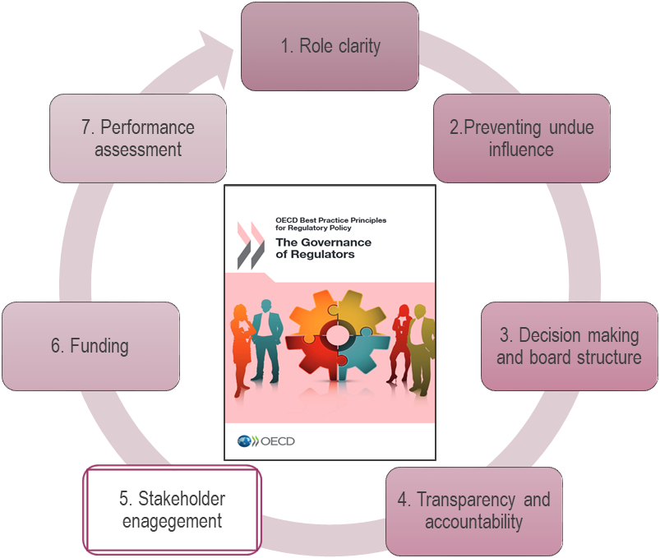
Stakeholder engagement
“Engagement should be inclusive and transparent…
Inclusive consultation allows any regulated party or member of the public to contribute or comment on proposals, rather than just representative groups
Transparent engagement involves publicly documenting who has been consulted and what their input has been and the release of the regulator’s responses to the main issues
-OECD (2014), Best Practice Principles on the Governance of Regulators
Notes:
Stakeholder engagement is an important component of accountability and transparency, and helps regulators collect input for decision making. Regulators may conduct stakeholder engagement relating to regulatory decisions as well as other aspects of their work, such as operational policies (OECD, 2014[6]). Most regulators publish draft decisions and collect feedback from stakeholders, even if there is no formal requirement to do so (Figure 5.18). Compared to peers in other sectors, a greater proportion of regulators in the transport sectors do not publish draft decisions for stakeholder comment. Box 5.3, which summarises results from the expansion of the indicators to twelve energy regulators in francophone African countries, shows that stakeholder engagement is an area for improvement in this group.

Slide 12
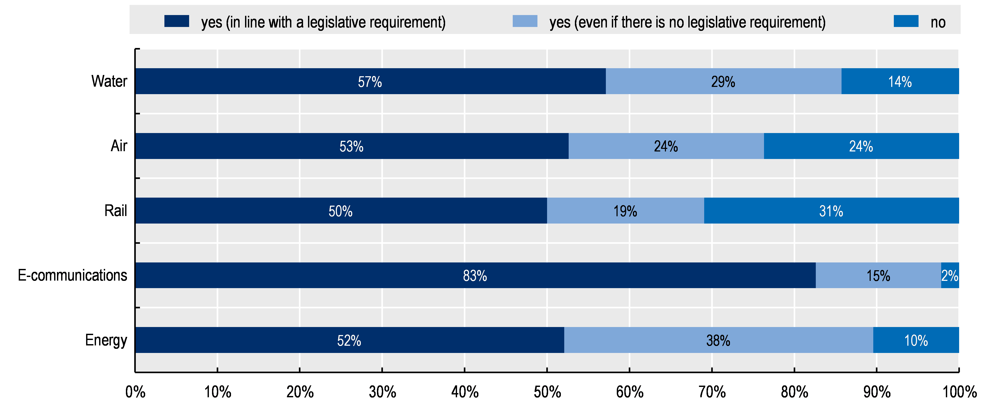
Most regulators publish draft decisions for comment
Proportion of answers to the question “Do regulators publish draft decisions and collect feedback from
stakeholders?” by sector
Source(s): OECD (2021), Regulatory Policy Outlook 2021; OECD (2022), Driving Performance at Peru’s Water and Sanitation Services Regulators Sunass
Notes:
Stakeholder engagement is an important component of accountability and transparency, and helps regulators collect input for decision making. Regulators may conduct stakeholder engagement relating to regulatory decisions as well as other aspects of their work, such as operational policies (OECD, 2014[6]). Most regulators publish draft decisions and collect feedback from stakeholders, even if there is no formal requirement to do so (Figure 5.18).

Slide 13
Thank you for your attention
For more information:
OECD Network of Economic Regulators: oe.cd/3NB
The Governance of Regulators: oe.cd/3Vm
Marta Baxter, Acting Senior Policy Analyst
Martha.Baxter@oecd.org

Slide 14
The OECD issued practical guidelines on how to create a “culture of independence”
Role clarity and responsibility
Clarity of role and relations in law
Transparency and accountability
Performance reporting
Transparent engagement
Financial independence
Funding source
Leadership
Staff behaviour
Nomination
Strategic foresight function
Outreach to government entities
Feedback and appeals
Ethics code
Multiyear budget
Autonomous management
Ext. and int. audit
Identification of needs
Appointment
Mandates
Conflict of interest
Exiting process
Recruitment
Incentives
Salary scales
Employment restrictions
Source(s): OECD (2017), Creating a Culture of Independence: Practical Guidance against Undue Influence

Slide 15
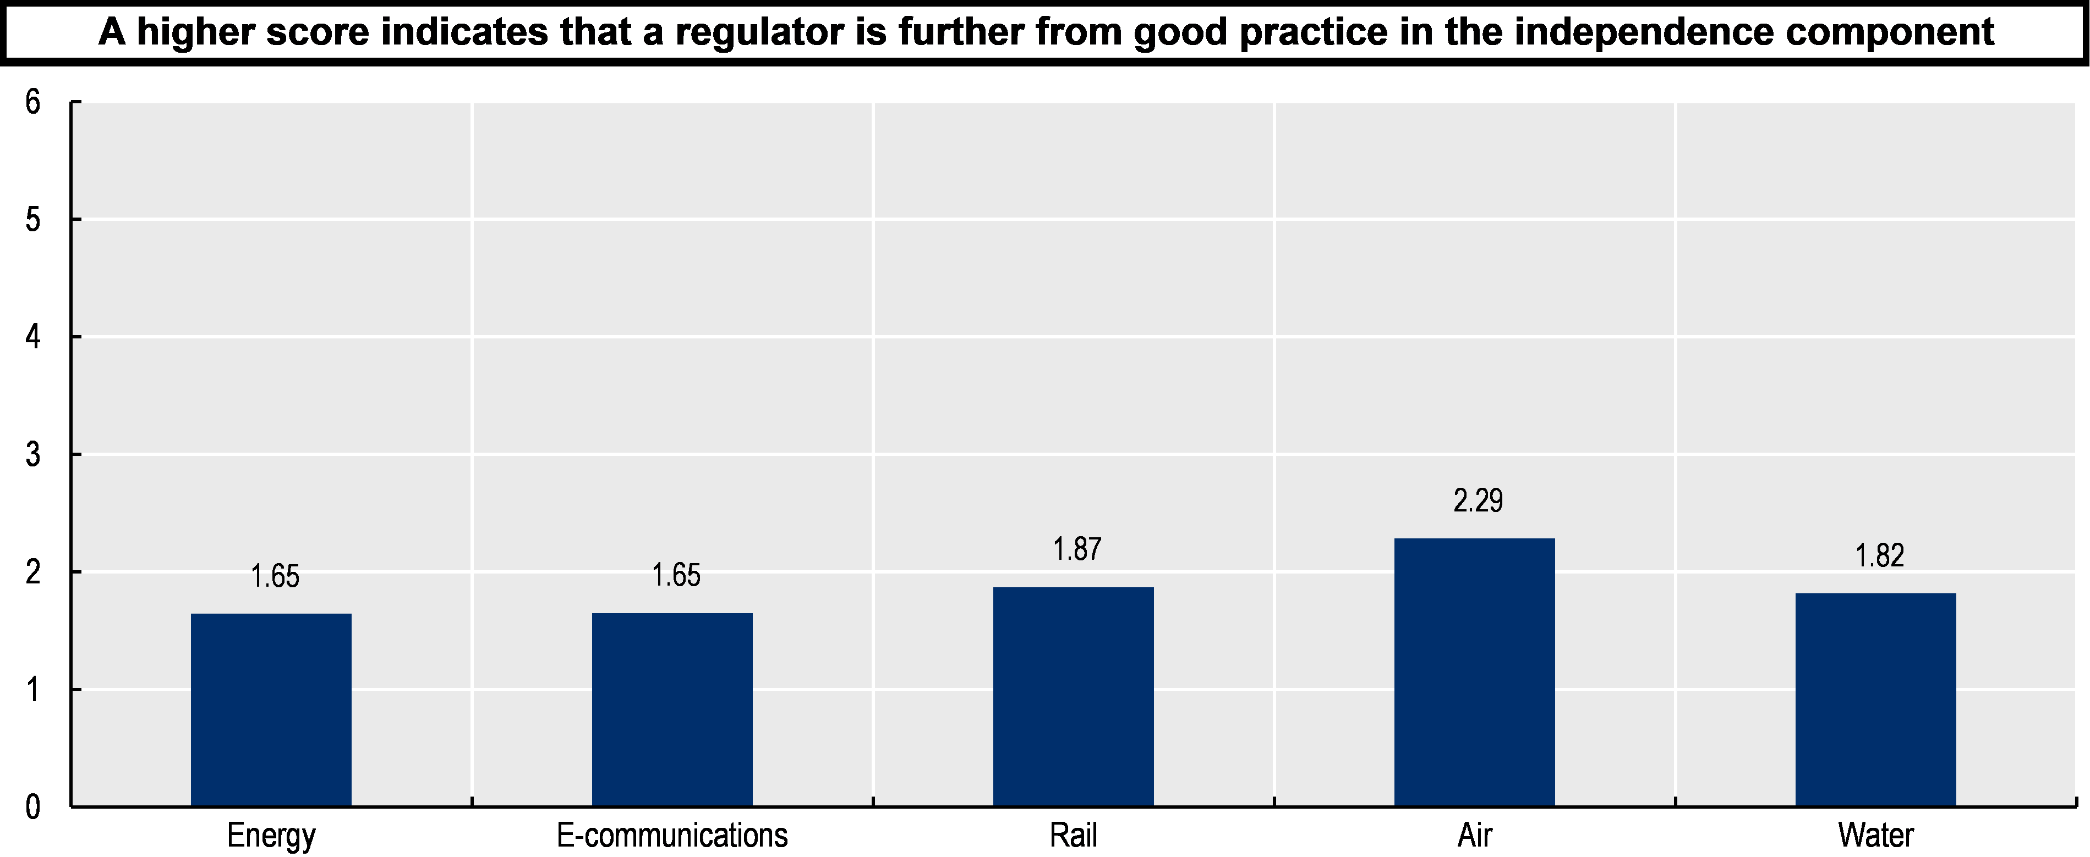
Indicators on the Governance of Sector Regulators: Independence across sectors

Slide 16
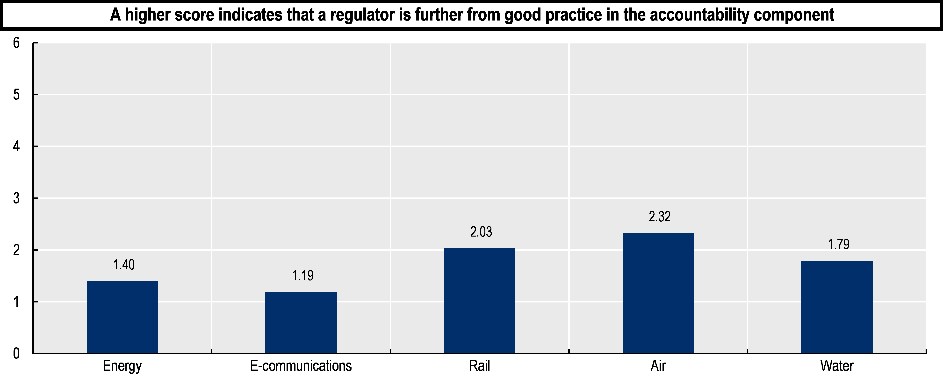
Indicators on the Governance of Sector Regulators: Accountability across sectors

Slide 17
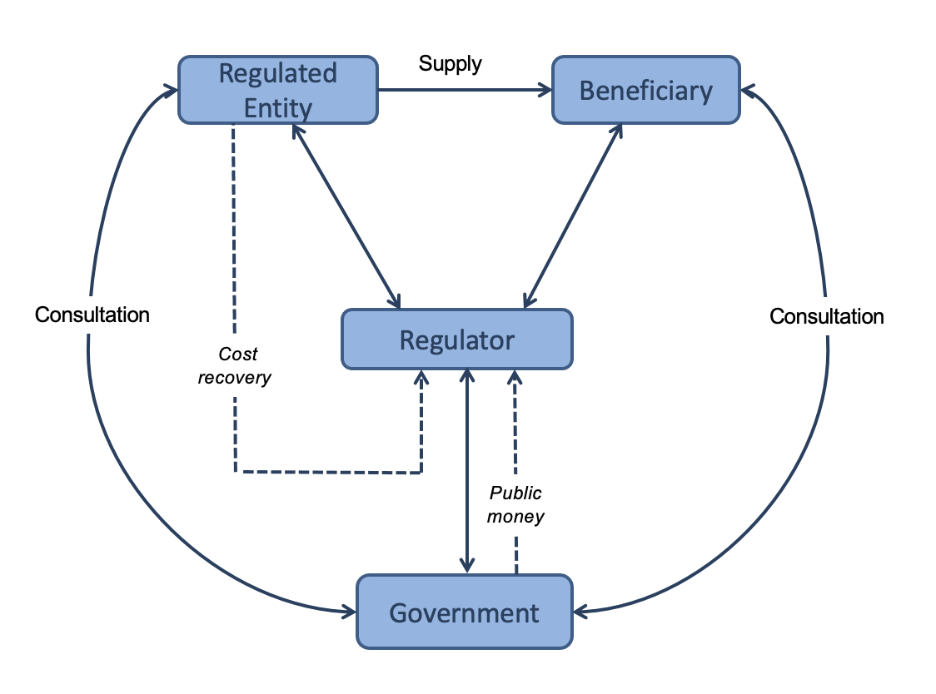
Accountable to whom?
There are six different coloured slides to choose from:
Cyan; Gold; Green; Lime; Magenta; and Orange.
Use this layout for bulleted or plain text, charts, pictures or video
This is the default style for slides. To add one to your presentation, use:
    Home > New Slide and select Title and Content, or
    Insert > New Slide and select Title and Content
The ‘New Slide’ menu option shows the variety of slides available in this template – there are 16 slide designs in total:
    8 Cover slides;
    1 Section Header Slide;
    6 Content page slides; and a
    Quote page slide.

Slide 18
Ontario’s Administrative Authority model for regulating to advance a circular economy
INDR/OECD Online Practitioner Workshop
June 7, 2022
Frank Denton, CEO
Notes:
Thank you XX for having us here today. As XX said, today you will hear from two of RPRA’s leadership team: Myself and Mary, our newly appointed Registrar.
We think it is important that stakeholders understand that Mary and I responsible for two different portfolios in fulfilling RPRA’s mandate and hope that we can shed some light on that for stakeholders today so that everyone can better understand our operations.

Slide 19

Linear Economy
Government: regulate product standards and garbage disposal
Producers: take resources, make a product, sell to consumer
Consumers: buy it, throw out the packaging. Use it then throw it out
19

Slide 20

Circular Economy: Producer responsibility
In a circular economy:
Government
  makes laws requiring producers to meet targets for resource recovery
  Establishes a regulator to drive compliance
Producers
  Design goods so resources can be recovered
  Establish and run collection and recovery systems
  Report to regulator on recovery rates
Consumers encouraged to return used products and packages for reuse
20

Slide 21
RPRA Ontario’s circular economy regulator
Regulate the market, including operating a registry for producers to register and report on outcomes
Support businesses in understanding and meeting requirements
Enforce where necessary to drive compliance and competitive markets
Monitor outcomes – resource recovery rates as % of goods sold into Ontario
  Producers must submit data to prove targets met
Provide information to the Minister to support policy decisions
Provide information to the public about Ontario’s progress toward a circular economy
21

Slide 22
Ontario’s Delegated administrative authority model: third-party governance
Unique co-regulatory model in operation in Ontario since 1997
Government designs, makes and monitors the legislation and regulation
Administrative authority administers legislation
Minister retains overall accountability and responsibility for the legislation, regulations and performance of authority
Authority has operational, financial and legal responsibility for regulatory delivery
22

Slide 23









Ontario’s administrative authorities
Consumer Protection
Public Safety
Retirement Homes
Circular Economy
23

Slide 24
Operating Model
Administrative Authorities
Designated by Legislation
Operational Independence
A private, not-for-profit corporation
Arm’s-length & not a provincial agency
Managed by an independent board of directors
Self-financed
Responsible for day-to-day delegated service delivery
24

Slide 25
Key Roles and Responsibilities
MINISTER / MINISTRY
Accountable to the Legislative Assembly and the Public
Oversees authority
Recommends policy reforms
ADMINISTRATIVE AUTHORITY
Accountable to the Minister
Transparent to stakeholders
day-to-day decision-making
Manages risk and liability
SHARED RESPONSIBILITY
Communications
Stakeholder management
Policy development (ministry lead, authority supports)
25

Slide 26
AA Governance Framework
I. The Legislation
II. The Regulations
III. The Administrative Agreement
IV. By-laws & Operational Policies
Government decides
Sometimes in consultation with authority
Negotiated
AA discretion
(sometimes in consultation with gov’t)
26

Slide 27
benefits and Challenges
Key Advantages
Operational flexibility – expertise and nimbleness to respond quickly to emerging issues, best practices, and new technology in the marketplace Reduces cost of regulation to taxpayers Reduces size of government Minimizes burden on business (promotes a competitive marketplace) Cultural opportunities outside bureaucracy Free from legacy culture Risk taking and innovation Diversity in recruitment
Key Challenges
Communication risks/public perception (“privatization, no accountability”) Tension between costs on businesses who pay fees and resourcing needs to deliver Financial sustainability –dependence on financial health of industry Potential lack of alignment with government Small, non-government entity is a target for opposing stakeholders Separation between expertise and policy-making authority Surprises if government does not consult authority on policy
27

Slide 28
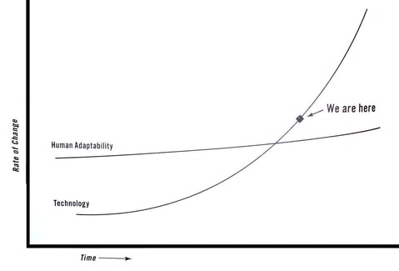
How will regulators keep up?
Well governed, independent regulators can move faster
28

